Slide 1
Chapter 8:
Structural Design Patterns

Slide 2
Objectives
To introduce structural design patterns
  Facade
  Decorator
  Composite
  Adapter
  Flyweight
  Proxy

Slide 3
Facade Design Pattern
Design Purpose
  Provide an interface to a package of classes.
Design Pattern Summary
  Define a singleton which is the sole means for obtaining functionality from the package.

Slide 4
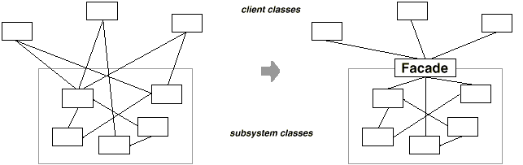
Facade: Motivation
Clients communicate with the package (subsystem ) by sending requests to Facade, which forwards them to the appropriate package object(s).

Slide 5
Facade: Applicability
To provide simple interface to a complex package, which is useful for most clients.
To reduce the dependencies between the client and the package, or dependencies between various packages.

Slide 6
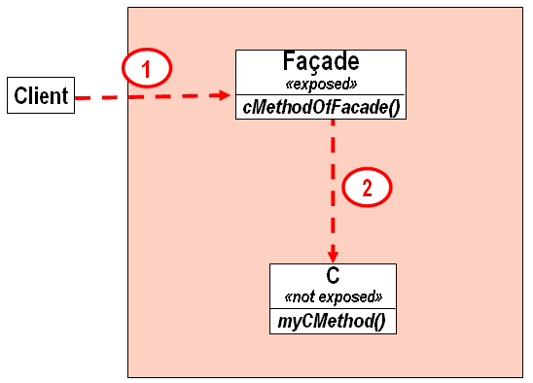
Facade: Structure

Slide 7
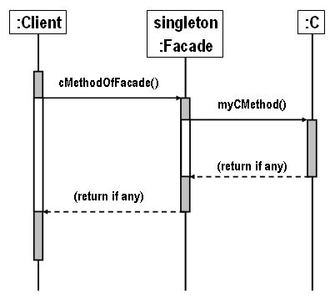
Facade: Sequence Diagram

Slide 8
Facade: Consequences
It shields clients from package components, thereby reducing the number of objects that clients deal with and making the package easier to use.
It promotes weak coupling between the package and its clients and other packages, thereby promoting package independence and portability.
It doesn't prevent applications from using package classes if they need to.

Slide 9
Decorator Design Pattern
Design Purpose
  Add responsibilities to an object at runtime.
Design Pattern Summary
  Provide for a linked list of objects, each encapsulating responsibility.

Slide 10
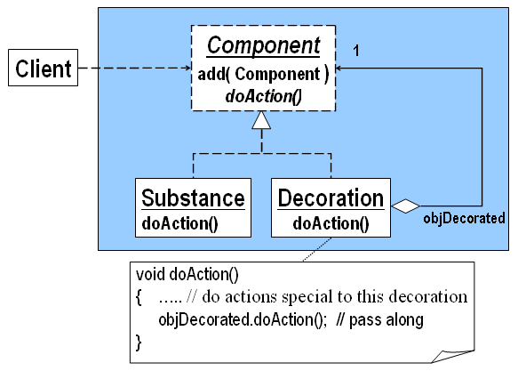
Decorator: Class Model
Decorator creates an aggregated linked list of Decoration objects ending with the basic Substance object.

Slide 11
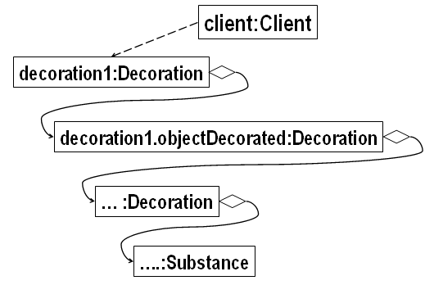
Linked Objects in Decorator

Slide 12
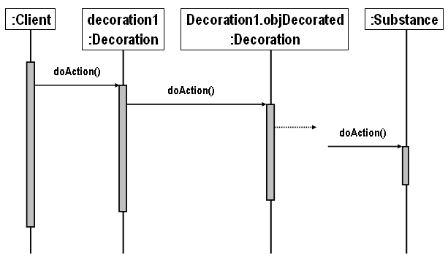
Decorator: Sequence Diagram

Slide 13
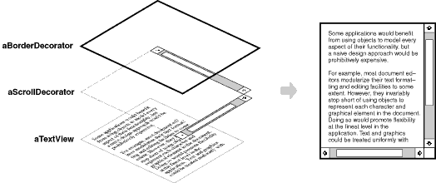
Text View Example

Slide 14
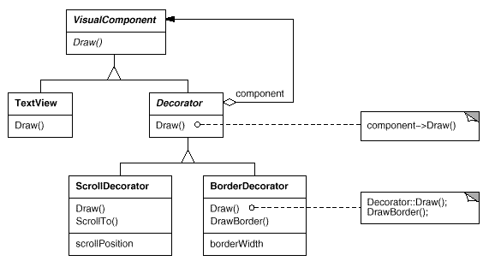
Text View Example (Cont’d)

Slide 15
Decorator: Consequences
Why use Decorator when a simple vector of Component objects seems to suffice?
  Instead of simple interface with a single Component object that Decorator provides, the client would have to know about the subclasses Substance and Decoration, thereby making the client code more specialized.
  If other classes replaced Substance or Decoration, the client code would have to change. This is not the case when Decorator is used.
Therefore, Decorator would make the client’s interface more flexible.

Slide 16
Composite Design Pattern
Design Purpose
  Represent a Tree of Objects.
Design Pattern Summary
  Use a Recursive Form in which the tree class aggregates and inherits from the base class for the objects.

Slide 17
Composite Design Pattern
Design Purpose
  Represent a Tree of Objects.
Design Pattern Summary
  Use a Recursive Form in which the tree class aggregates and inherits from the base class for the objects.

Slide 18
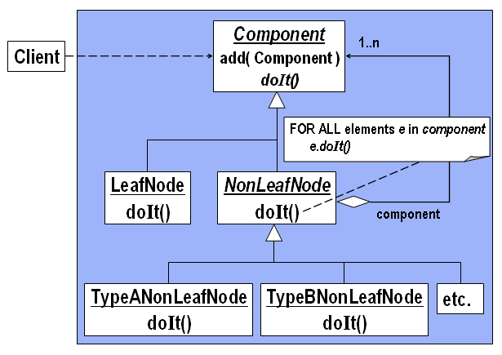
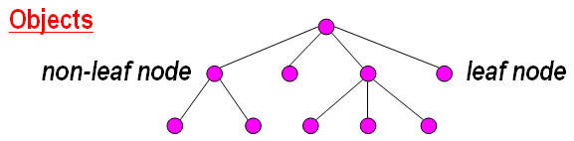
Composite: Class Model

Slide 19
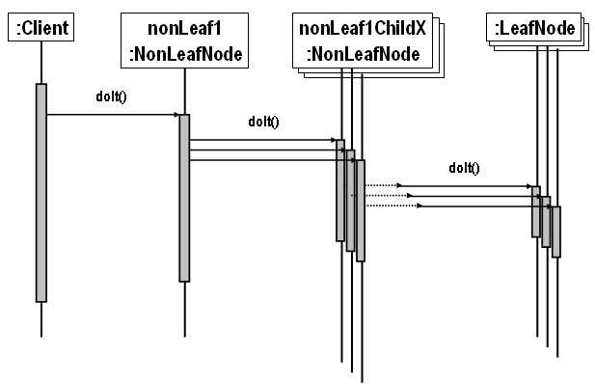
Composite: Sequence Diagram

Slide 20
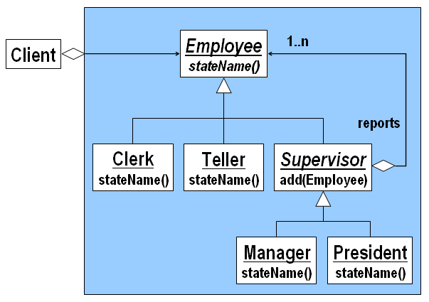
Bank/Teller Example

Slide 21
Bank/Teller Example

Slide 22
Composite: Consequences
Defines class hierarchies consisting of primitive objects and composite objects.
Makes the client simple.
Makes it easier to add new kinds of components.

Slide 23
Adapter Design Pattern
Design Purpose
  Allow an application to use external functionality in a retargetable manner.
Design Pattern Summary
  Write the application against an abstract version of the external class; introduce a subclass that aggregates the external class.

Slide 24
Adapter: Applicability
Use the Adapter pattern when
  you want to use an existing class, and its interface does not match the one you need.
  you want to create a reusable class that cooperates with unrelated or unforeseen classes, that is, classes that don't necessarily have compatible interfaces.

Slide 25
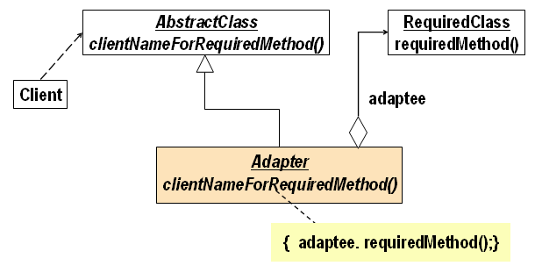
Adapter: Class Model
Adapter is based on the delegation form because an Adapter object delegates the command to the targeted command.

Slide 26
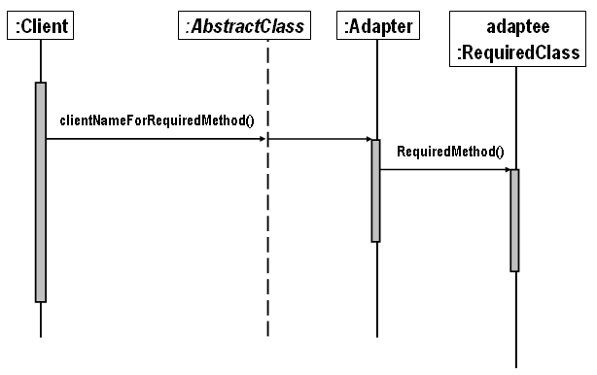
Adapter: Sequence Diagram

Slide 27
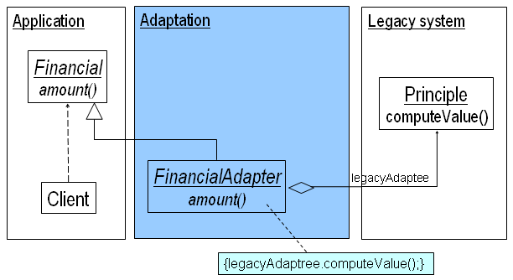
Financial Application Example

Slide 28
Adapter: Consequences
Adapter lets classes work together that couldn't otherwise because of incompatible interfaces.

Slide 29
Flyweight Design Pattern
Design Purpose
  Manage a large number of objects without constructing them all.
Design Pattern Summary
  Share representatives for the objects; use context to obtain the effect of multiple instances.

Slide 30
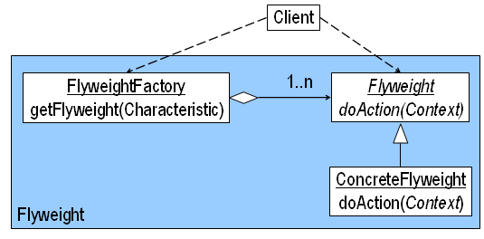
Flyweight: Class Model

Slide 31
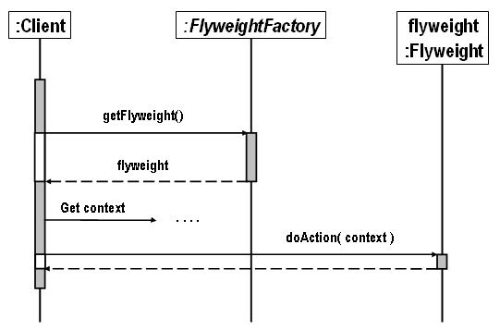
Flyweight: Sequence Diagram

Slide 32
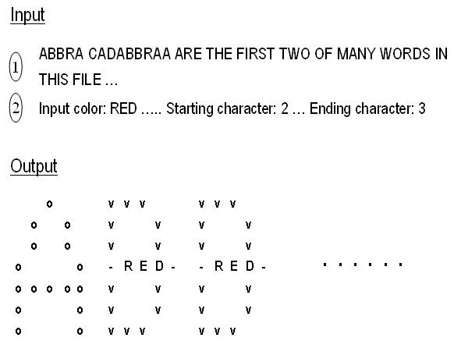
Text Magnifier Example

Slide 33
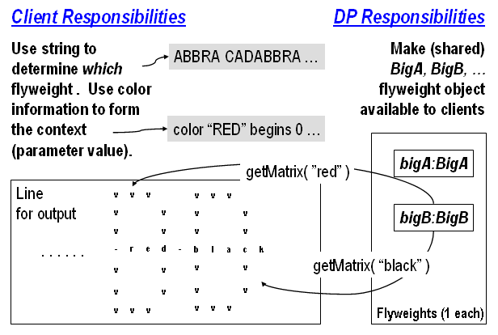
Text Magnifier Example (Cont’d)

Slide 34
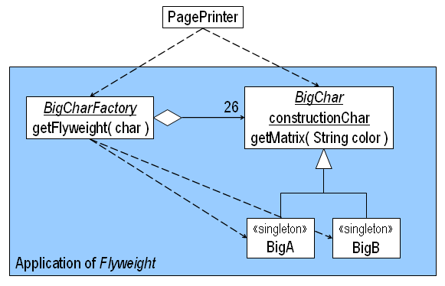
Text Magnifier Example (Cont’d)

Slide 35
Flyweight: Consequences
Space savings increase as more flyweights are shared.

Slide 36
Proxy Design Pattern
Design Purpose
  Avoid the unnecessary execution of expensive functionality in a manner transparent to clients.
Design Pattern Summary
  Interpose a substitute class which accesses the expensive functionality only when required.

Slide 37
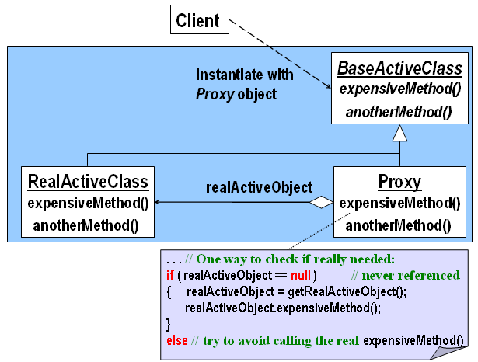
Proxy: Class Model

Slide 38
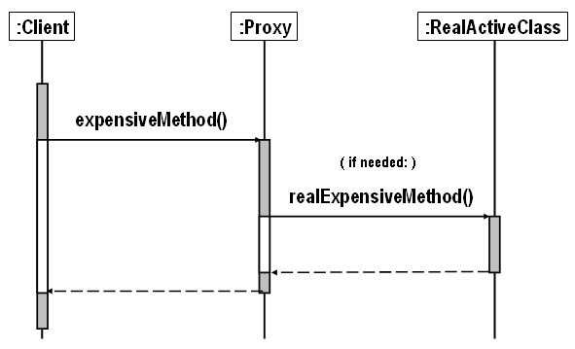
Proxy: Sequence Diagram

Slide 39
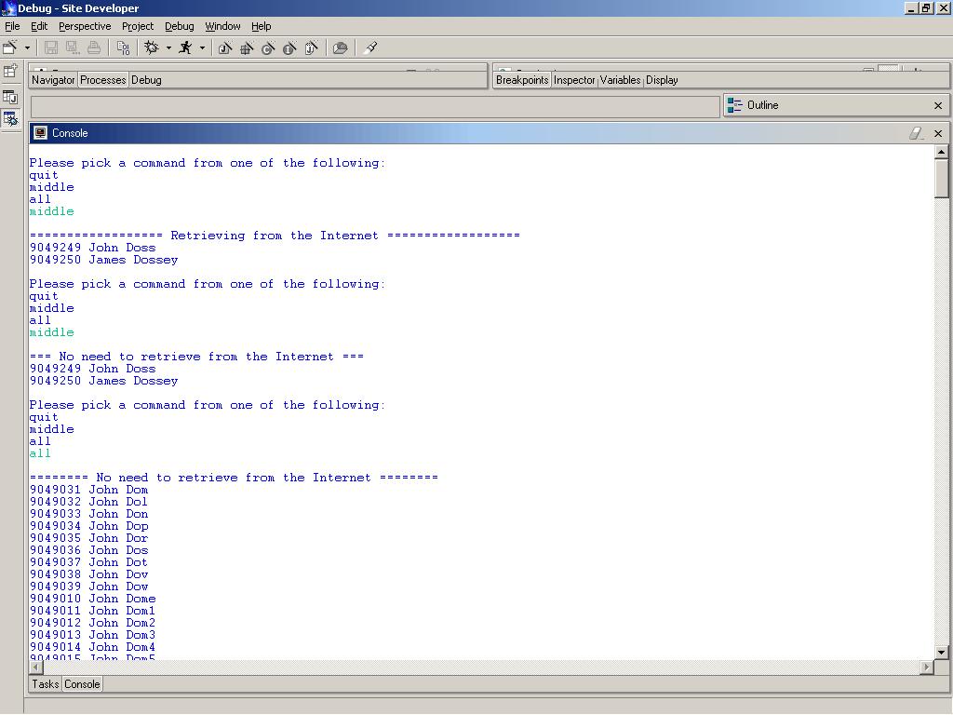
Telephone Record Example

Slide 40
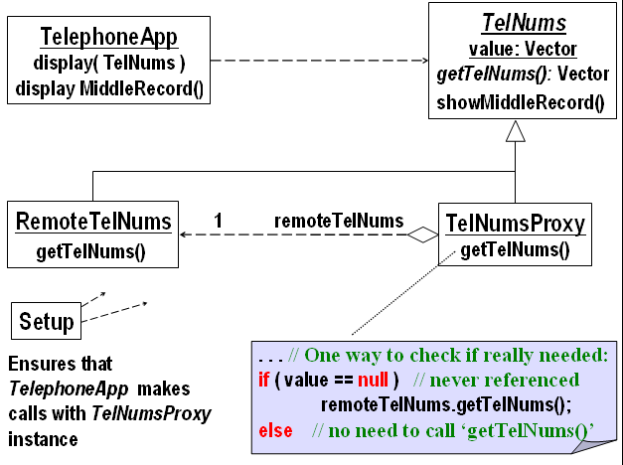
Telephone Record Example (Cont’d)

Slide 41
Proxy: Consequences
Proxy promotes:
  Efficiency: avoids time-consuming operations when necessary.
  Correctness: separates design and code that are independent of retrieval/efficiency from parts concerned with this issue.
  Reusability: design and code that are independent of retrieval efficiency are most likely to be reusable.
  Flexibility: we can replace one module concerned with retrieval with another.
  Robustness: isolates parts that check for the validity of retrieved data.
The penalties we pay can sometimes be too high:
  If the proxy forces us to keep very large amount of data in the memory and its use is infrequent.

Slide 42
Summary of Structural Design Patterns
Structural Design Patterns relate objects (as trees, lists etc.)
  Facade provides an interface to collections of objects
  Decorator adds to objects at runtime
  Composite represents trees of objects
  Adapter simplifies the use of external functionality
  Flyweight gains the advantages of using multiple instances while minimizing space penalties
  Proxy avoids calling expensive operations unnecessarily

